Slide 1

WELCOME ORANGE DIGITAL CENTER BUEA UNIVERSITY
INTERNSHIP 2023
Presented by:
Betrand Ajebua

Slide 2
Internship Facilitators
Dr. Melingui M. Robert (Manager)
Mr. Betrand Ajebua
Mr. Nfor Nde Nyambi
Mr. Ajong Trevor
Mr. Mbah Naoussi Jordan Wilfry
ODC Buea University

Slide 3
Internship Activities
Weekly Cleaning
Web Development Training:
HTML
CSS
JavaScript
NodeJs and reactJs
Personal Research and findings( task, assignment and project development)
ODC Buea University

Slide 4
Rules and Regulation
Runs on Tuesday – Saturday(9am-3pm) .
Late coming from 10 not Allowed.
Record of daily attendance.
ID card is a necessity to gain access.
ODC Buea University

Slide 5
Training Methodology
Weekly Task.
6 hours daily
3 hours Practical Tutorials
3 hours Personal Research
Weekly Presentation of task.
ODC Buea University

Slide 6
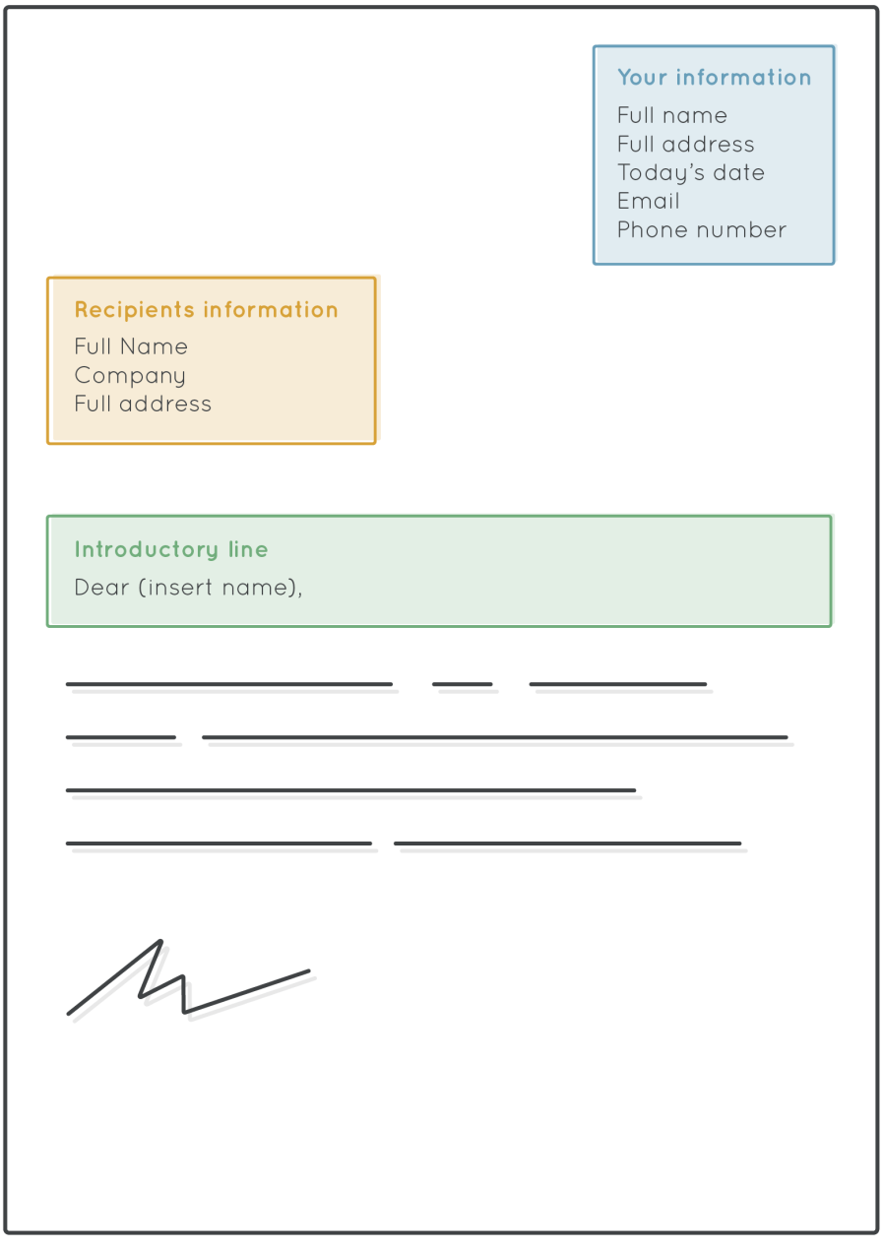
Writing an Internship Letter
Structure

Slide 7
Parts of the Letter
Sender’s Address:
Name
Home Address
Phone number
Email
Country(optional)

Slide 8
Parts of the Letter
Date
The date on which the letter was writen

Slide 9
Parts of the Letter
Receivers Address
Name
Position in Company
Company
Company Address

Slide 10
Parts of the Letter
Introductory Line
Greetings
Purpose for Writing

Slide 11
Parts of the Letter
Body
State your source
Give good qualities of your personality
Back the qualities up with your experience
State your reaction if accepted

Slide 12
Sample body
Dear Sir,
please allow me apply for an internship in the Software department at the Orange Digital Center which was posted on the ODC WhatsApp group, which is why I was drawn to this exiting opportunity.
I am a level 200 student, currently studying software engineering at the college of Technology. I am smart and always willing to learn new things in the domain of Software Engineering. In addition to that, I have been opportuned to take several web development courses and training both online and onsite. I believe with this, I will be able to add value to your company.
I will be grateful if my request is granted(
other options
Thank you for considering my application.
I look forward to the opportunity to discuss my qualifications further.
)
Yours Sincere(Respectfully, with gratitude, Sincerely, thank you)
B.E.A
Betrand Ajebua

Slide 13
Writing CV
Outline
What research needs to be done b4 you start writing your CV
How to structure your cv to best please recruiters and hiring managers
How to format your cv to professional outlooks
How to write a profile that will grab recruiter attention
How to detail your work experience and education

Slide 14
Writing CV
Steps to follow
Pre CV writing research
Focus on hard skills(industry specific skills, IT system, language and qualification)
How to structure your cv to best please recruiters and hiring managers
How to format your cv to professional outlooks
How to write a profile that will grab recruiter attention
How to detail your work experience and education

Slide 15
Design
Keep font and colors simple so it can be easily read. Ex black text on white background
Not More than 2 page, try to keep it concise if you want to hold employers attention.

Slide 16
Thanks For Listening

